Slide 1
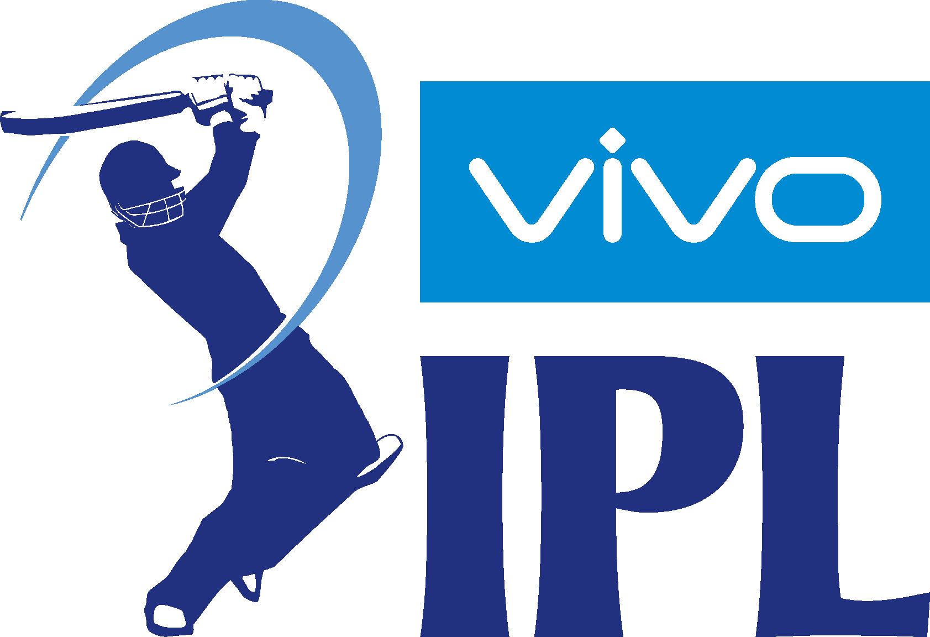
IPL Insights
2008-2018

Slide 2
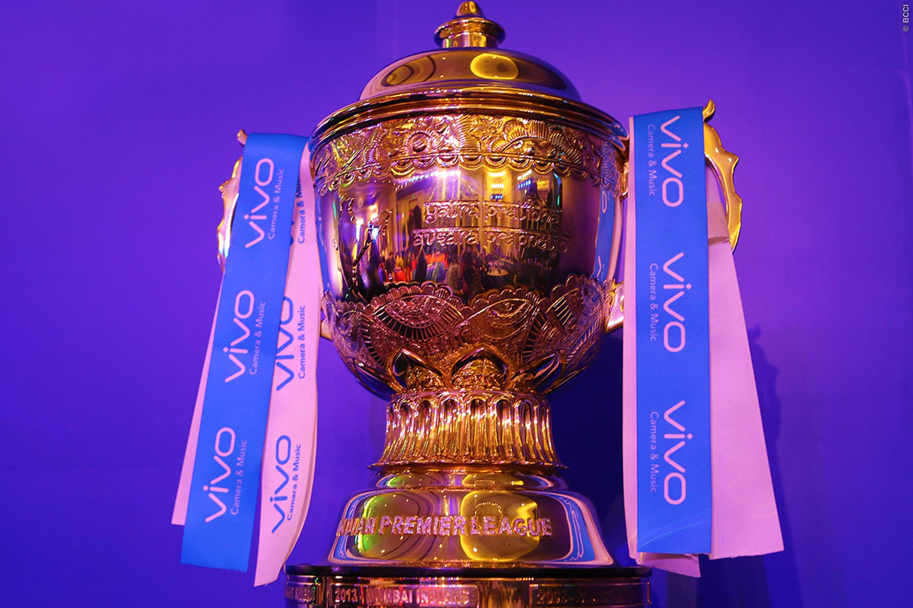
Indian Premier League
(IPL)
The Indian Premier League (IPL) is a professional Twenty20 cricket league in India contested during March or April and May of every year by eight teams representing eight different cities in India.
The league was founded by the Board of Control for Cricket in India(BCCI) in 2008.
The IPL is the most-attended cricket league in the world and in 2014 ranked sixth by average attendance among all sports leagues.
In 2010, the IPL became the first sporting event in the world to be broadcast live on YouTube.
The brand value of IPL in 2018 was US$6.3 billion, according to Duff & Phelps.
According to BCCI, the 2015 IPL season contributed ₹11.5 billion to the GDP of the Indian economy.
There have been twelve seasons of the IPL tournament. The current IPL title holders are the Mumbai Indians, who won the 2019 season.
Festival Season for Indians…

Slide 3
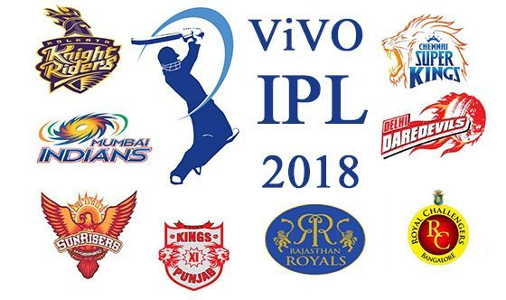
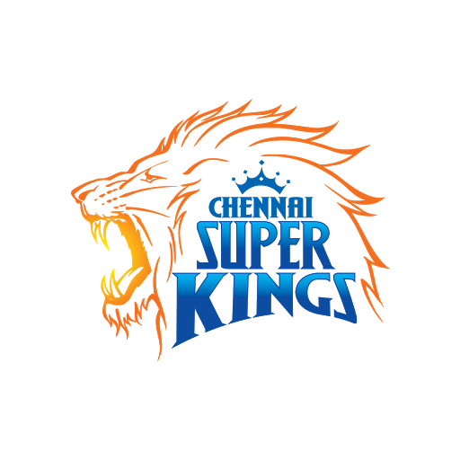
Teams Participated 2018 season
And
Crowned IPL 2018 Champions As Shane Watson Blitzes Sunrises Hyderabad In Final

Slide 4
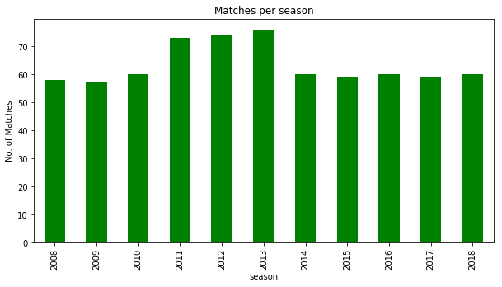
Number Of Matches Held Season Wise

Slide 5

Number of matches won by each team at each season
IPL Season 2008-2018

Slide 6
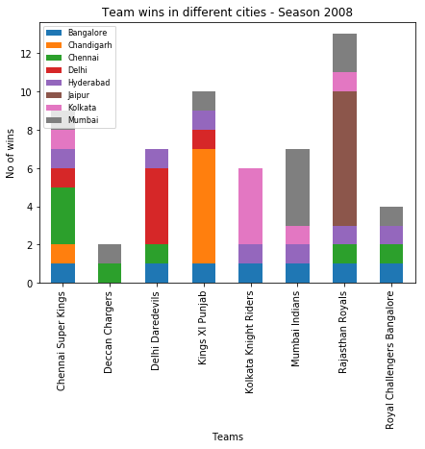
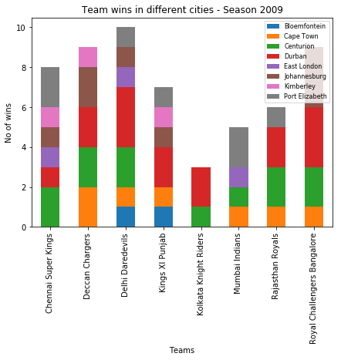
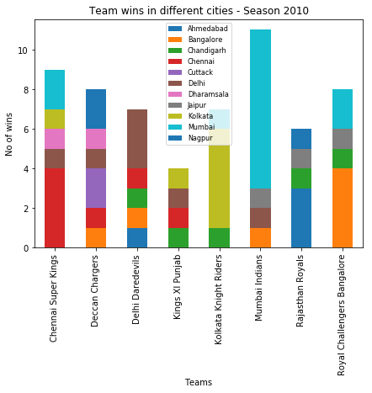
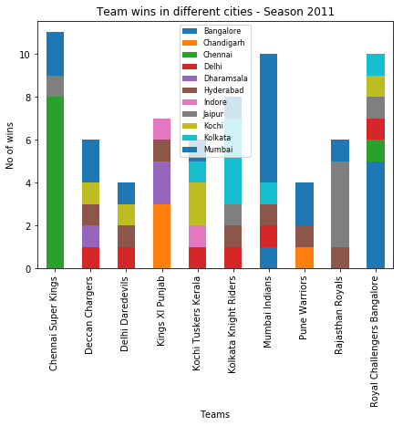
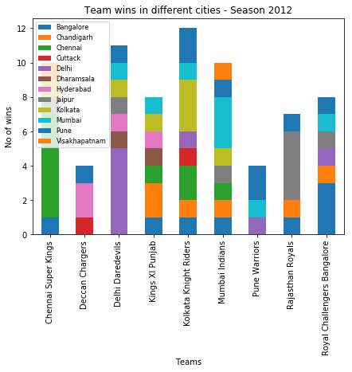
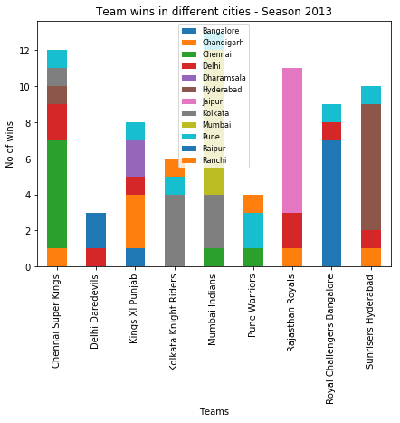
Number of matches won by each team at each season
2008-2018

Slide 7
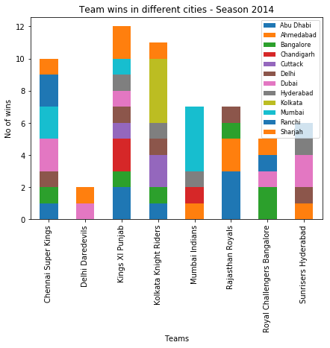
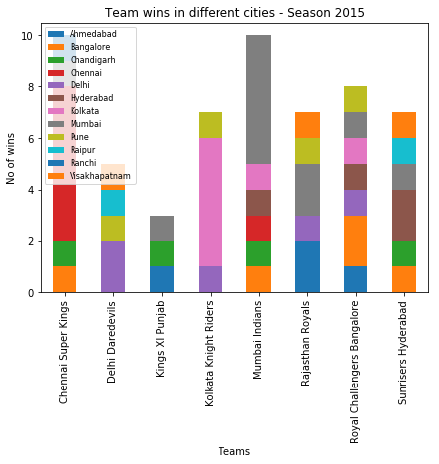
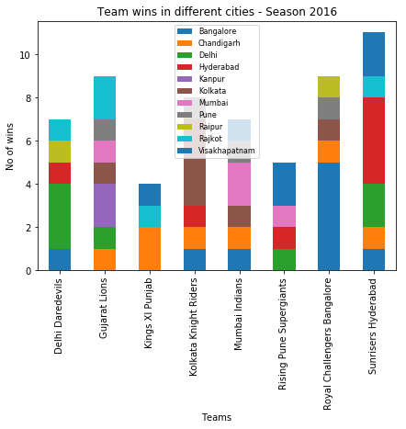
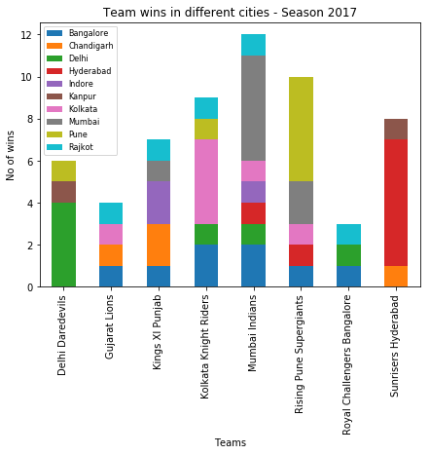
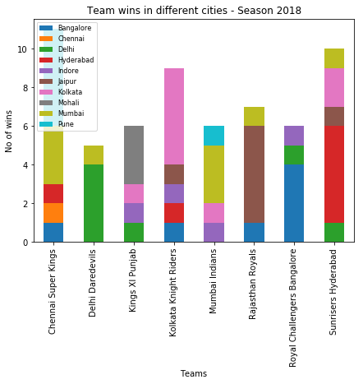

Slide 8
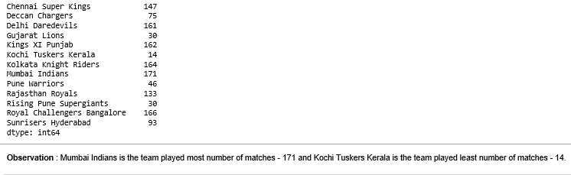
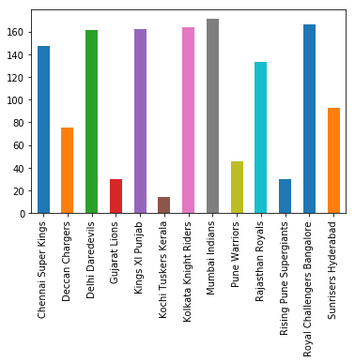
Total matches played by each team

Slide 9
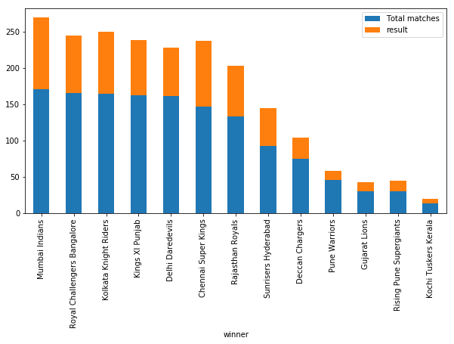
Number of matches won by each team and total matches played
Mumbai Indians, Chennai Super Kings has more wins against total number of matches played by each team and Pune Warriors has least wins against total matches played by them.

Slide 10
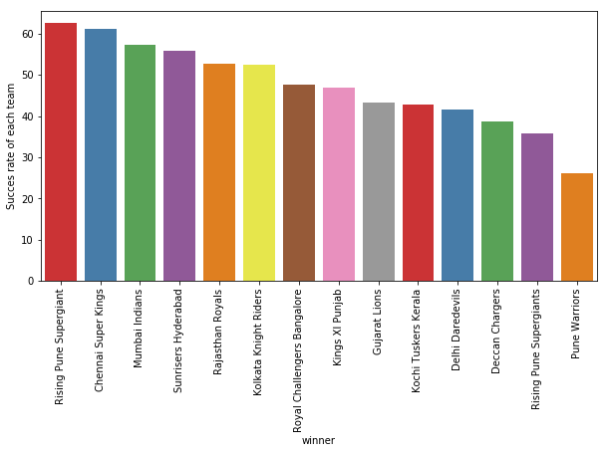
Success Rate of each team
Team Name | Success Rate(%)
Chennai Super Kings | 61.2
Mumbai Indians | 57.3

Slide 11
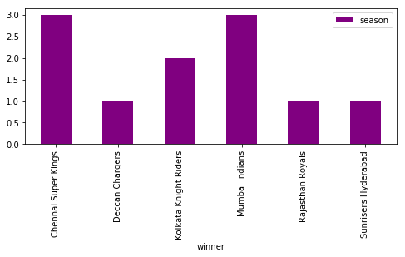
Team won maximum seasons ?

Slide 12

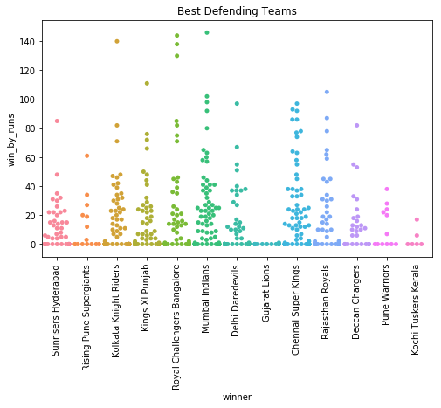
Best Teams – Defending/Chasing

Slide 13
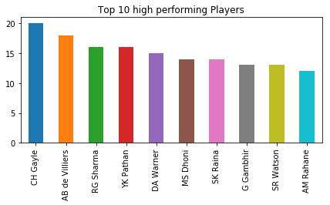
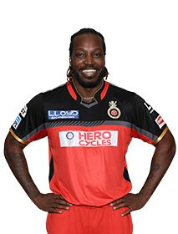

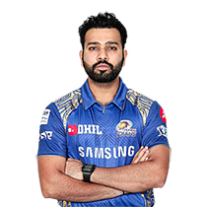
Top 10 high performing Players
Chris Gayle
AB de Villiers
Rohit Sharma

Slide 14
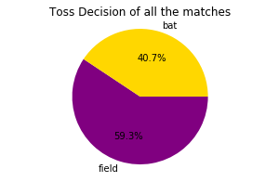
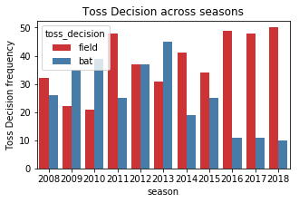
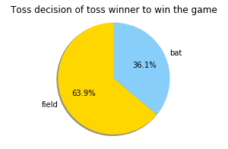
Toss Decision

Slide 15
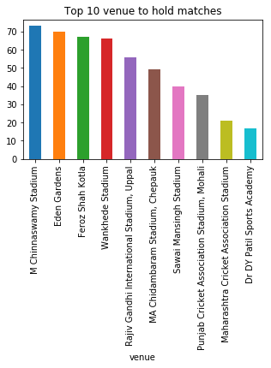
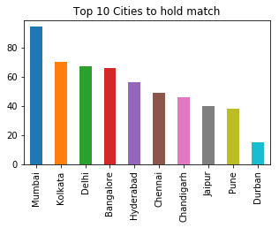
Top 10

Slide 16
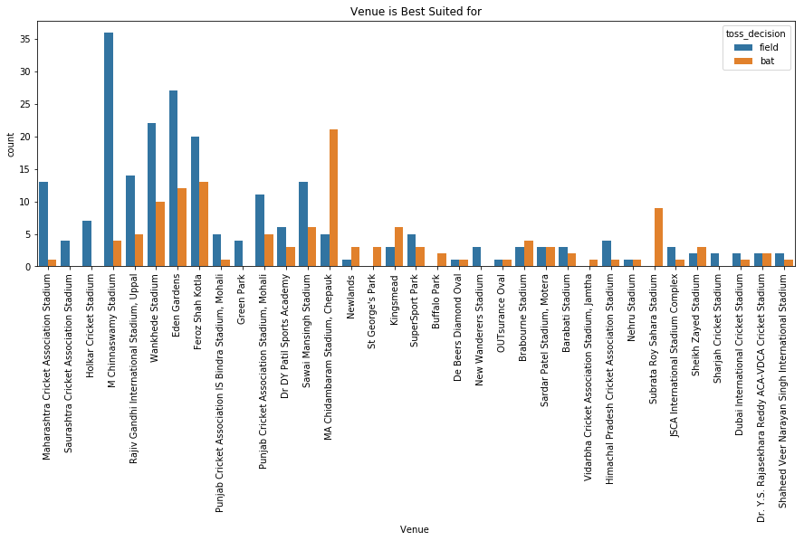
Venue : Best Suited for batting or fielding

Slide 17
IPL 2019
Recently season 2019 has been conducted in month of Apr-May, 2019
We have experienced some the greatest performances of this season by all the teams participated.
The current IPL title holders are the Mumbai Indians, who won the 2019 season. Mumbai beat Chennai Super Kings in final match at Hydrabad.
Mumbai Indians have won the IPL title for the fourth time and Chennai have won 3 title till season 2019.

Slide 18
Facts about IPL :
Most number of matches has played in season 2013 - 76 matches
Mumbai Indians is the team played most number of matches - 171 and Kochi Tuskers Kerala is the team played least number of matches – 14
Mumbai Indians won 98 matches in all IPL seasons (2008-2018)
Mumbai Indians won the match by most runs i.e. 146 in season 2017.
Royal Challengers Bangalore is a best chasing team, had won the match many times with maximum wickets.
Mumbai Indians, Chennai Super Kings has more wins against total number of matches played by each team and Pune Warriors has least wins against total matches played by them.
Chennai Super Kings have highest winning success rate (61.2%) , followed by Mumbai Indians (57.3%).

Slide 19
Facts about IPL : Continued …
Chennai Super Kings and Mumbai Indians won 3 seasons each
Mumbai Indians, Royal Challengers Bangalore, Chennai Super kings and Sunrisers Hyderabad are best Defending teams.
Royal Challengers Bangalore, Mumbai Indians and Kolkata Knight Riders are the best Chasing teams.
Chris Gayle is leading the chart with most valuable player of all the season, followed by ABD and Rohit Sharma.
59.3% of the toss winning teams have opted for Fielding while 40.7% have opted for Batting.
In season 2008,2011 and, from 2014 to 2018 teams were more interested in chasing the target, while in remaining seasons teams were preferred to set a target for opponent and they have chosen to bat first.

Slide 20
Facts about IPL : Continued …
Number of matches in which Toss winner is the game winner is : 357 out of 696 ie., 51.293103448275865 %
63.9% of the toss winning teams had decided to field first while 36.1% had decided to Bat first and won the matches.
Mumbai had hold highest number of matches (94) followed by Kolkata (70).
M Chinnaswamy Stadium had hold highest number of matches (73) followed by Eden Gardens (70).
M Chinnaswamy stadium and Eden Gardens is best Suited for Feilding and MA Chidambaram Stadium ,Chepauk is best suited for Batting.

Slide 21
Conclusion
Mumbai Indians and Chennai Super Kings likely to win more matches
After analyzing the IPL data for season 2008-2018, we observed that Mumbai Indians and Chennai Super Kings are the teams who are more likely to win the IPL Season.

Slide 22
References
https://en.wikipedia.org/
https://www.google.com/
https://www.kaggle.com/
https://github.com/
https://www.youtube.com/

Slide 23
Thank You !!!

